Slide 1

AI Assisted In-Game Non-Player Character Behavior Interaction
Jiacong Huang（黄嘉聪）
College of Computer Science and Software Engineering
Shenzhen University
2024-12-8

Slide 2
1. The Group Project
Outline
2. Types of AINPC and It’s Introduction
3. The Response and Conclusion

Slide 3
1. The Group Project
Outline
2. Types of AINPC and It’s Introduction
3. The Response and Conclusion

Slide 4

The Group Project
1
Abstract
The use of AI in MMORPGs is evolving, particularly in improving NPC interactions. Developers are using context-aware AI to create more natural, personalized NPC responses, enhancing player immersion and autonomy within the game world.

Slide 5
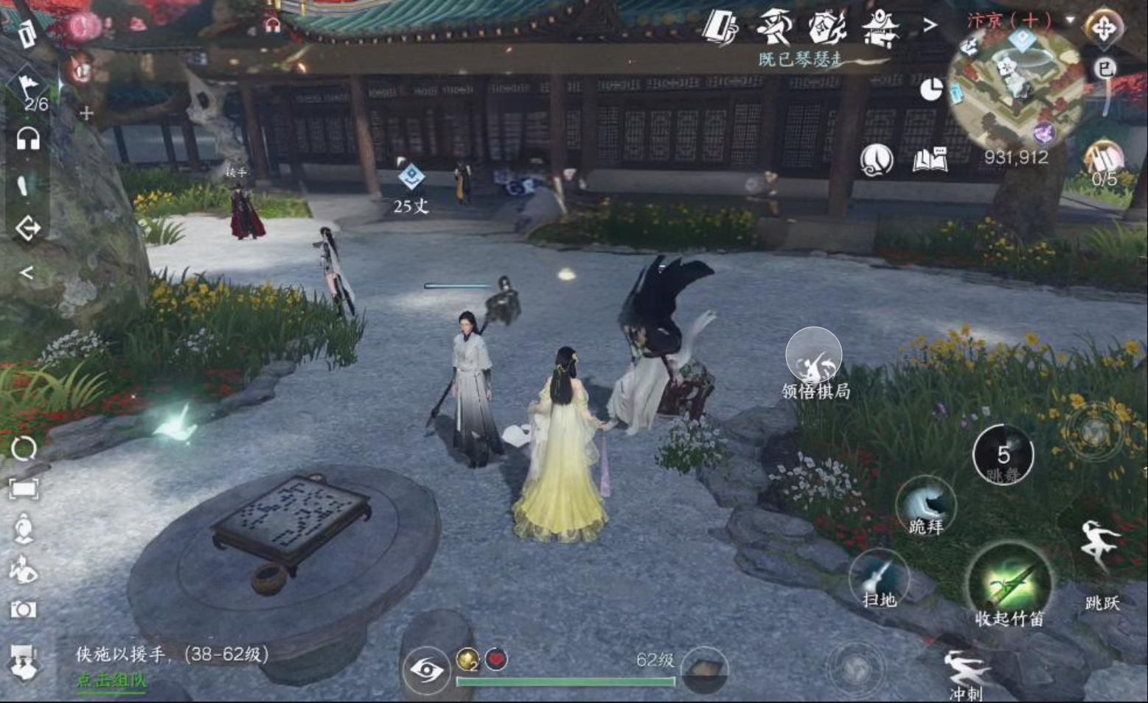
The Group Project
1
I. Introduction
AI technology is transforming MMORPGs, traditionally used in combat systems, by introducing more dynamic and context-aware NPC interactions. This approach enhances narrative depth and player autonomy, moving away from pre-scripted dialogues to adaptive, personalized NPC behaviors.

Slide 6

The Group Project
1
II. Methodology
The study introduces an intelligent agent framework that incorporates context awareness and decision-making algorithms. This system allows NPCs to respond dynamically to player actions, creating more realistic and adaptive behaviors in an MMORPG setting.

Slide 7
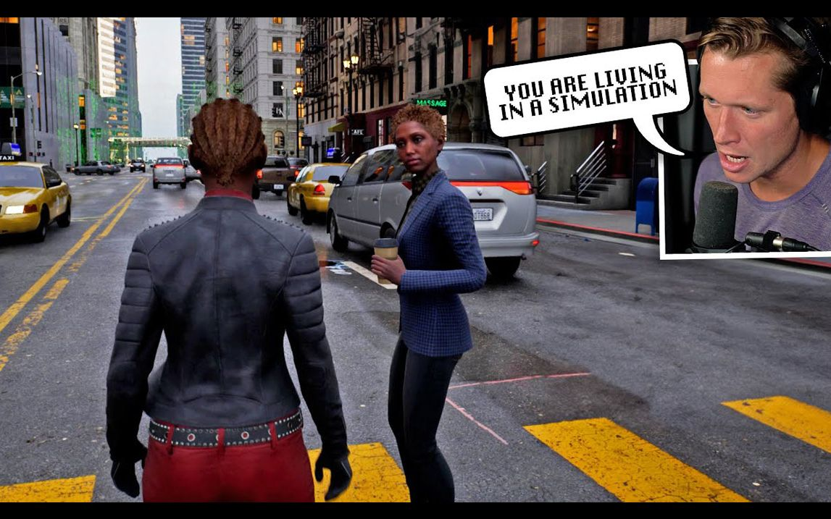
The Group Project
1
IV. Conclusion
The AI-assisted system significantly improves NPC realism and interactivity, making MMORPGs more immersive. As AI continues to develop, it is poised to revolutionize NPC behavior and player engagement, offering more satisfying and memorable gameplay experiences.

Slide 8
1. The Group Project
Outline
2. Types of AINPC and It’s Introduction
3. The Response and Conclusion

Slide 9
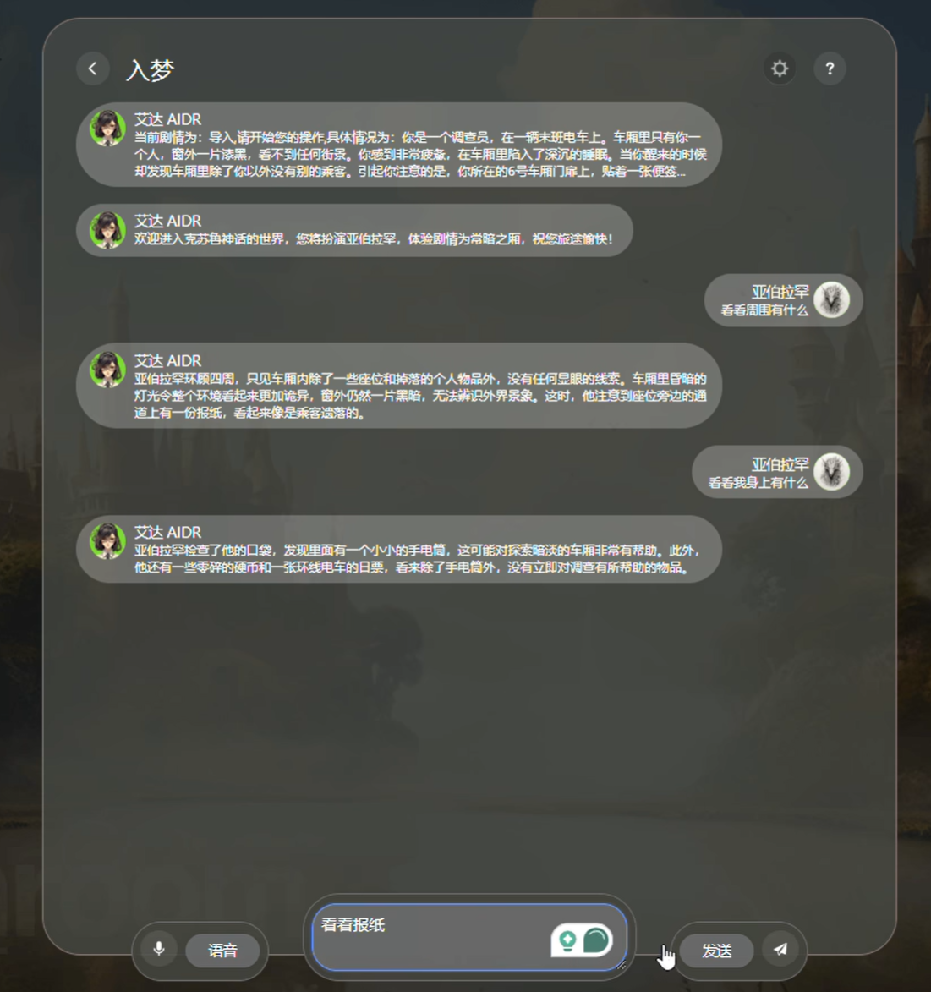
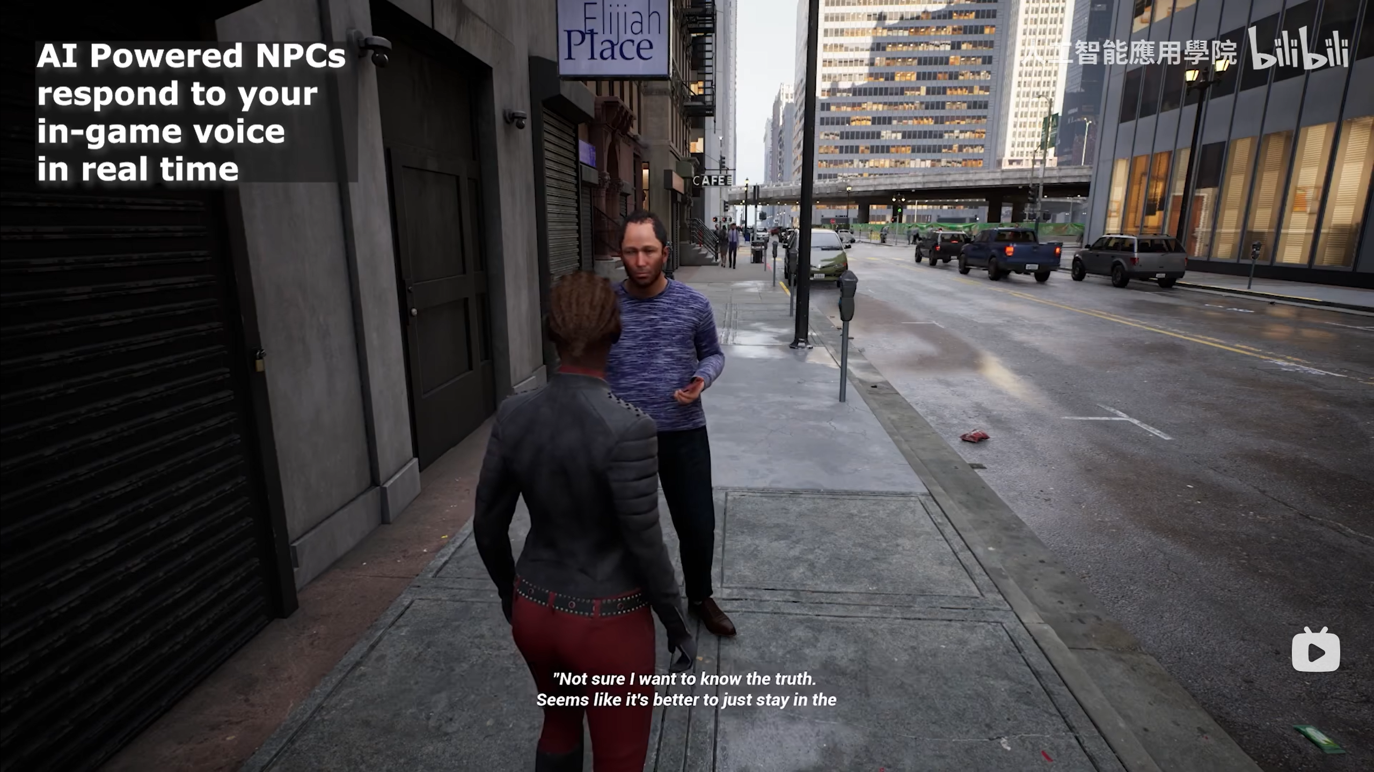
Types of AINPC and It’s Introduction
2
The first type: large language model dialog AI NPC
Take typing
Conversing with speech

Slide 10
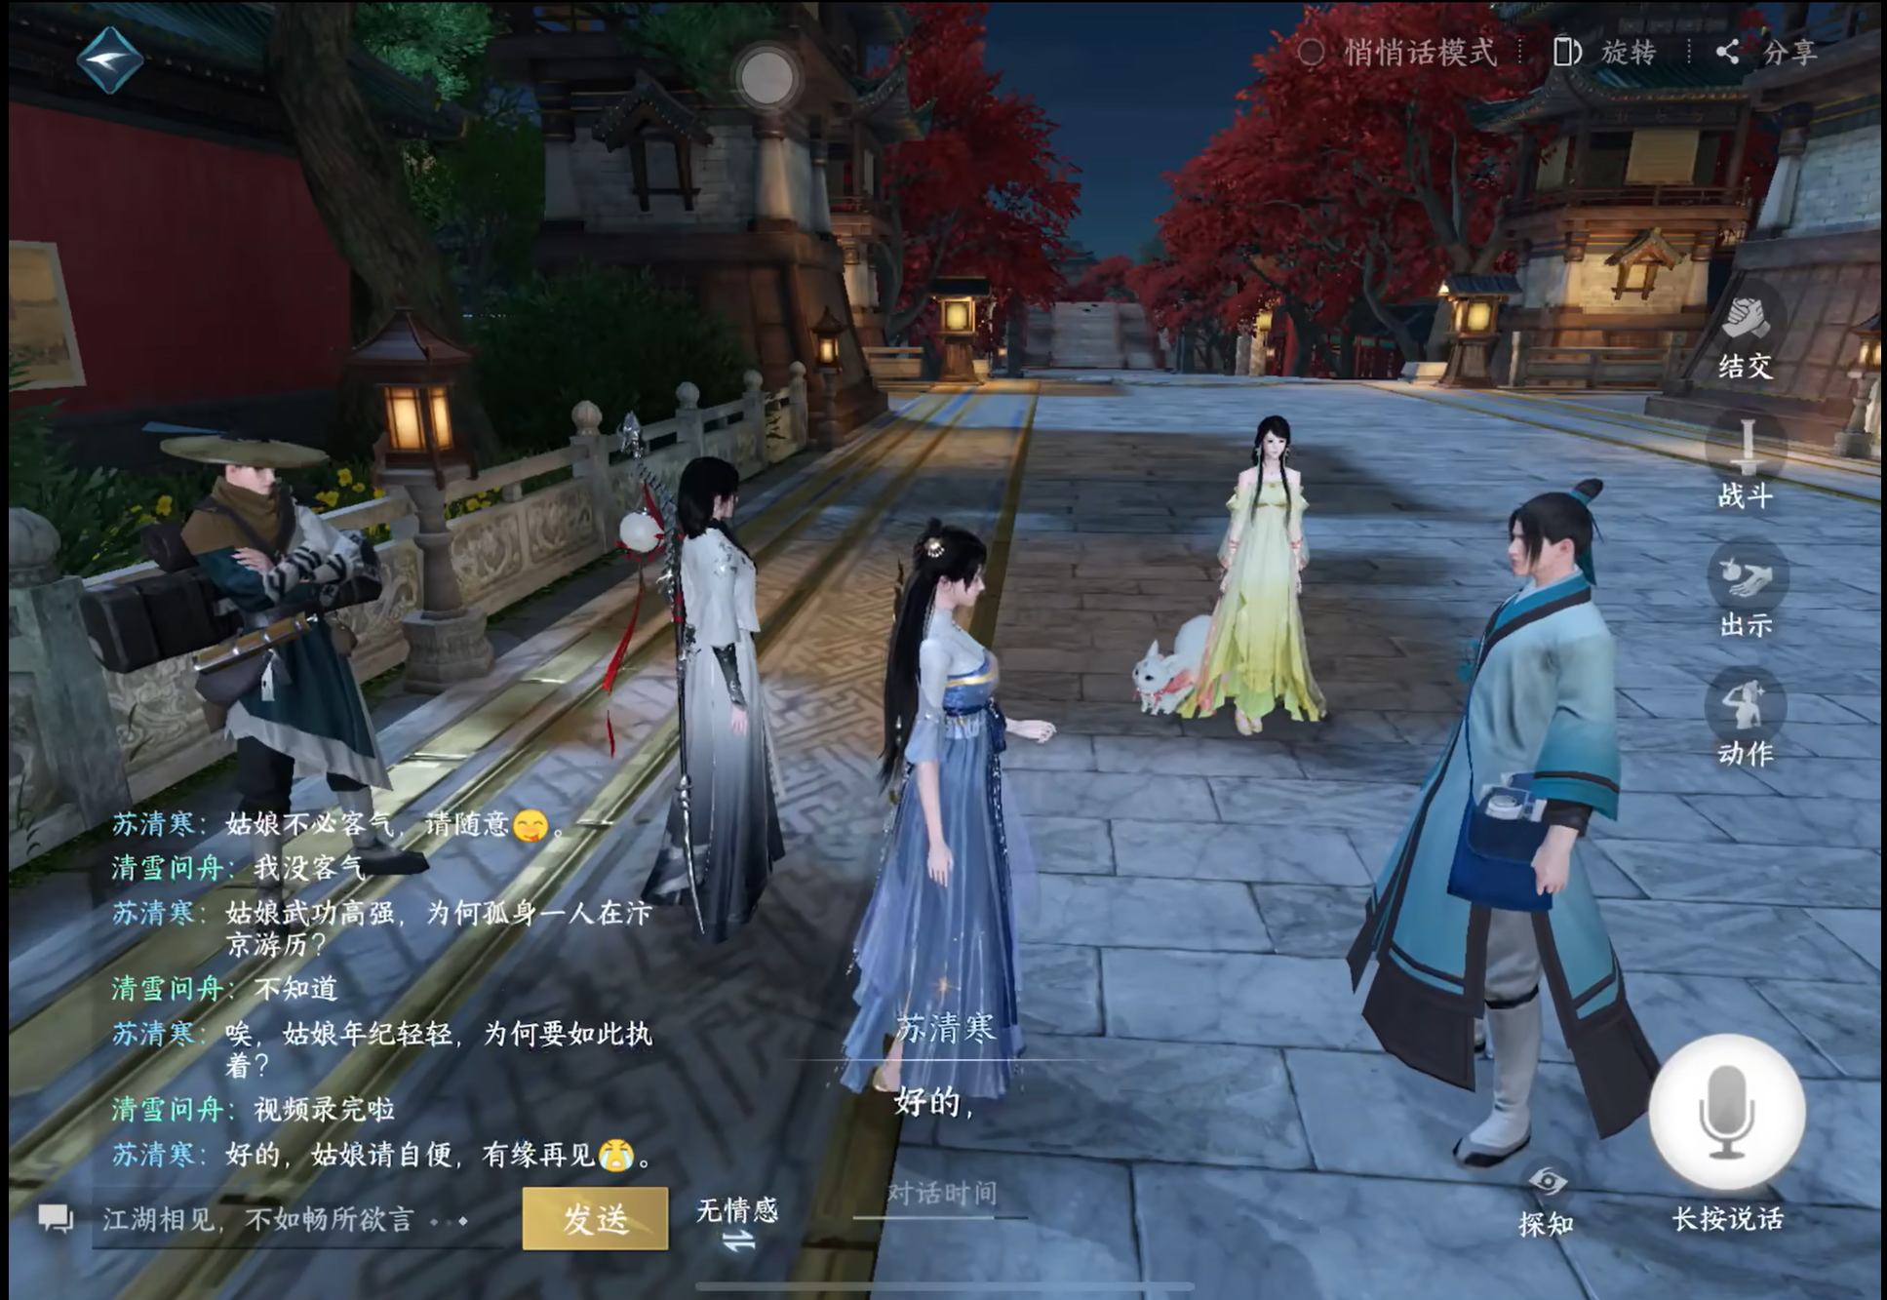
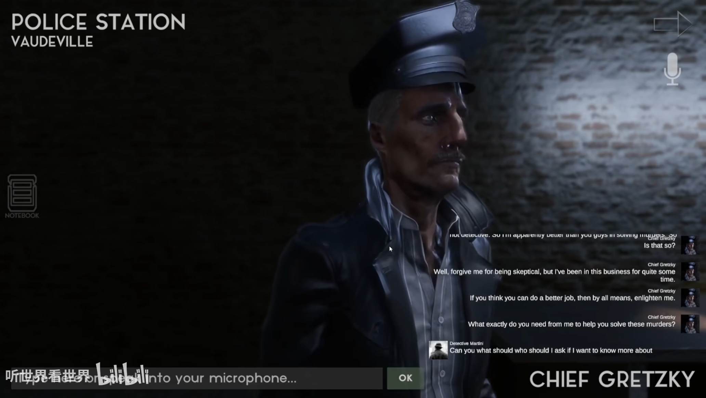
Types of AINPC and It’s Introduction
2
The second type: situational dialog NPC
In NiShuiHan
Talk With police

Slide 11
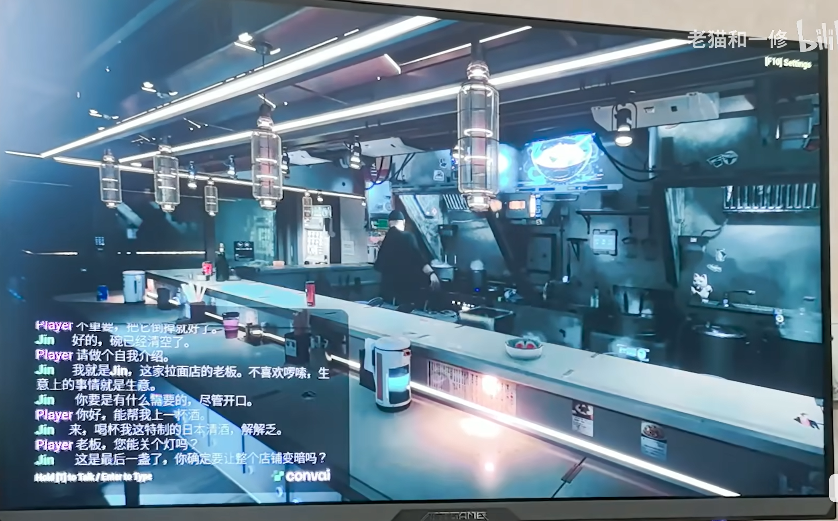
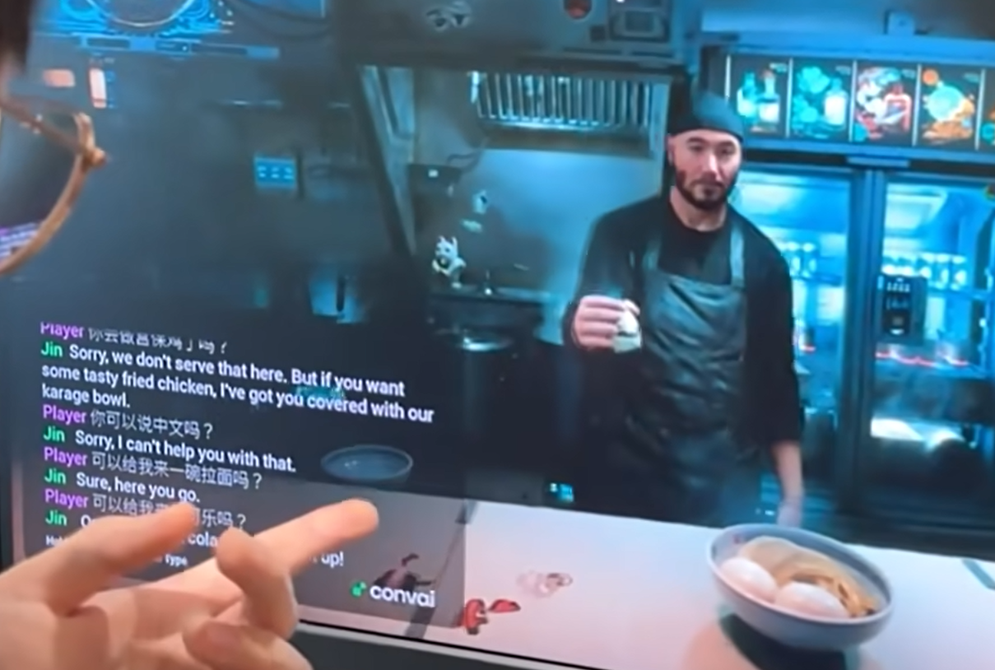
Types of AINPC and It’s Introduction
2
Third type: performs appropriate actions based on dialogs
Turn off the light
Make and get something

Slide 12
1. The Group Project
Outline
2. Types of AINPC and It’s Introduction
3. The Response and Conclusion

Slide 13


The Response and Conclusion
3
The Response

Slide 14
The Response and Conclusion
3
The Conclusion
AINPCs can greatly reduce the distinction between them and real players, and compared to traditional NPCs that only repeat and operate in a fixed way, they can greatly display behaviors that are more similar to those of real people, thus enhancing the immersion in multiplayer games.

Slide 15

Thanks for your attention

